Slide 1

COMM223 Marketing Management
Lecture 9 – cost-based pricing, break-even, demand estimates and Channel

Slide 2
Quiz 2
Quiz 2 is on the Moodle during the class time on March 28
Including Product, Price, and Place (Chapters 7, 8, 9 and 10)

Slide 3
Agenda
Pricing calculation
Demand estimates
Place
Why marketing channel
Channel behavior
Channel decision
Channel management

Slide 4
Pricing calculation
A hypothetical manufacturer of consumer electronics products – HD.
The product can play videos and television programming streamed over the internet on multiple devices in a home, including high-definition televisions, tablets, and mobile phones.

Slide 5
Price setting based on costs
Cost-based pricing (cost-plus pricing)
Fixed cost: $20millions
Variable cost: $125 per unit
Expected sales: 1 million units
Markup: 25%
Determining cost:
Units cost = variable + fixed costs/unit sales = $125+$20,000,000/1,000,000 = $145
Break-even price: $145
Mark-up price = unit cost/(1-desired return on sales) = $145/(1-0.25)=$193.33

Slide 6
Price setting based on external factors
Wholesalers and retailers need to be considered
Dollar markup = selling price – cost
Markup percentage on cost = dollar markup/cost
Markup percentage on selling price = dollar markup/selling price

Slide 7
Price setting based on external factors
Suppose retailers expect a 30% margin and wholesalers want a 20% margin based on their respective selling prices
HD sets a manufacturer’s suggested retail price (MSRP) of $299.99 for its product.
Suggested retail price: $300
Minus retail margin (30%): -$ 90
Retailer’s cost/wholesaler’s price: $210
Minus wholesaler’s margin (20%): -$ 42
Wholesaler’s cost/HD’s price: $168

Slide 8
Break-even analysis
Break-even volume = fixed costs/(price-unit variable cost)
Break-even volume = $20,000,000/($168-125) = 465,116.2 units
BE sales = BE volume * price = 465,117 * $168 = $78,139,656

Slide 9
Break-even for profit goals
Assume that HD would like to realize a $5 million profit
Unit volume = (fixed cost + profit goal)/(price – variable cost) = ($20,000,000+$5,000,000)/($168-$125) = 581,395.3 units
Dollar sales = 581,396 units * $168 = $97,674,528

Slide 10
Demand estimates
Total market demand: the total volume that would be bought by a defined consumer group in a defined geographic area in a defined time period in a defined marketing environment under a defined level and mix of industry marketing effort.
Market potential: the upper limit of market demand
Q = n*q*p
Q = total market demand
n – number of buyers in the market
q = quantity purchased by an average buyer per year
p = price of an average unit

Slide 11
Demand estimates
Chain ratio method: estimating market demand by multiplying a base number by a chain of adjusting percentages.
Total number of US households * the percentage of HDTV-owning US household with broadband internet access * the percentage of these households willing and able to buy this device = 113 million household * 0.6 *0.3 = 20.34 million households

Slide 12
Demand estimates
Assuming that HD forecasts it will have a 3.66% market share in the first year after launching this product.
Unit sales = 20.34 million units * 0.0366 = 744,444 units
Exceeds break-even volume
Also exceeds volume necessary to realize a $5 million profit

Slide 13
Where are we now …
Company
Company Analysis
Competitor Analysis
Consumer Analysis
Marketing Management
Competitor
Consumer
Product
Promotion
Price
Distribution
Product - Market

Slide 14
Supply Chains and the Value Delivery Network
A supply chain consists of upstream and downstream partners
Marketers have traditionally focused on the downstream side
Supply chain – make-and-sell view
Demand chain – sense-and-respond-view
Value Delivery Network
A network composed of the company, suppliers, distributors, and, ultimately, customers who partner with each other to improve the performance of the entire system in delivering customer value.
供应链由上游和下游合作伙伴组成
营销人员传统上专注于下游
供应链——制造和销售视图
需求链——感知和响应视图
价值传递网络
由公司、供应商、分销商以及最终的客户组成的网络，他们相互合作以提高整个系统在交付客户价值方面的性能。

Slide 15
Nature and Importance of Distribution Channels
Marketing channel
Set of interdependent organizations involved in the process of making a product or service available for use or consumption by the consumer or business user.
在使产品或服务可供消费者或企业用户使用或消费的过程中涉及的一组相互依赖的组织。

Slide 16
Nature and Importance of Marketing Channels
Channel choices affect other decisions in the marketing mix
Pricing, marketing communications
A strong distribution system can be a competitive advantage
Channel decisions involve long-term commitments to other firms

Slide 17
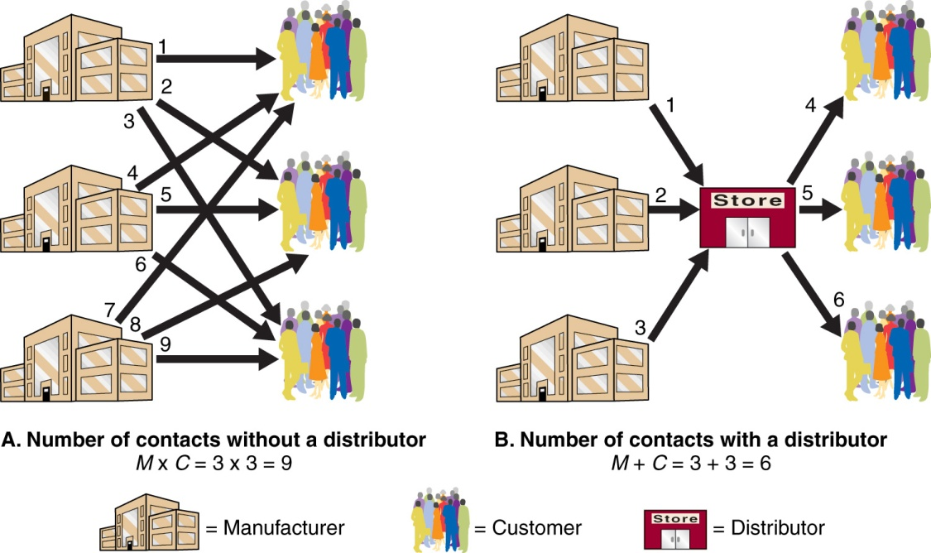
Nature and Importance of Marketing Channels
How Channel Members Add Value
Greater efficiency
Match product assortment demand with supply.
Bridge, time, place, and possession gaps that separate products from users.

Slide 18
How Channel Members Add Value
Help to complete transactions
Information
Promotion
Contact
Matching
Negotiation
Help to fulfill the completed transactions
Physical distribution
Financing
Risk taking

Slide 19
Nature and Importance of Marketing Channels
Channel level: A layer of intermediaries that performs work in bringing the product and its ownership closer to the final buyer
Number of Channel Levels
The number of intermediary levels indicates the length of a marketing channel.
Direct Channels
Indirect Channels
Producers lose more control and face greater channel complexity as additional channel levels are added.

Slide 20
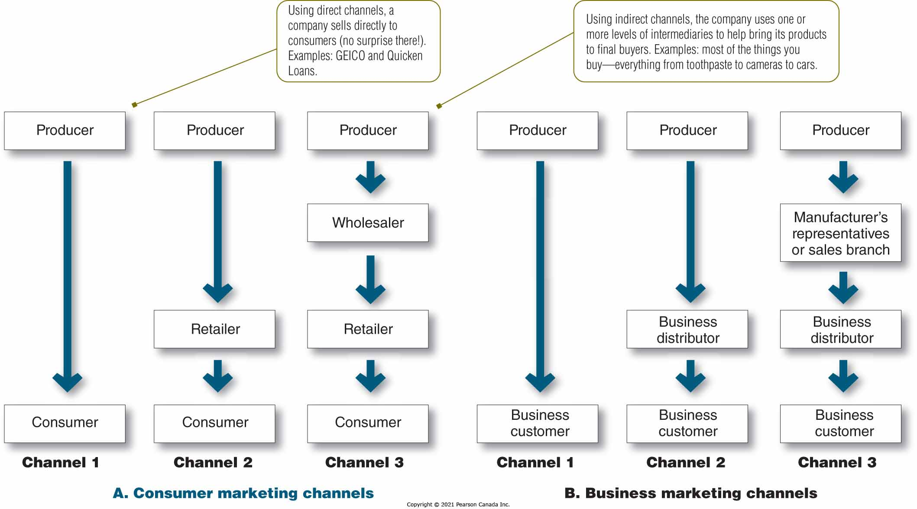
Customer and Business Distribution Channels

Slide 21
Channel Members are Connected via a Variety of Flows
Physical Flow
Payment Flow
Information Flow
Promotion Flow
Flow of Ownership

Slide 22
Channel Behaviour and Organization
Channel Conflict
Occurs when channel members disagree on roles, activities, or rewards.当一个渠道成员的行为与其渠道合作者的期望相反时，便会产生渠道冲突。
Types of Conflict:
Horizontal conflict: occurs among firms at the same channel level
Vertical conflict: occurs among firms at different channel levels

Slide 23
Channel Conflict
Vertical
Dealer A
Dealer B
Dealer C
Horizontal

Slide 24
Channel Behaviour and Organization
Conventional Distribution Channels传统渠道系统是指有各自独立的生产商、批发商、零售商和消费者组成的分销渠道。 传统渠道成员之间的系统结构是松散的。
Consist of one or more independent channel members
Each seeking to maximize its own profits
Often result in poor performance
Vertical Marketing Systems垂直营销系统是由生产者、批发商和零售商所组成的统一联合体。Producers, wholesalers, and retailers act as a unified system
One channel member owns, has contracts with, or has so much power that they all cooperate
Benefits should include greater control, less conflict, and economies of scale due to the size of the system

Slide 25
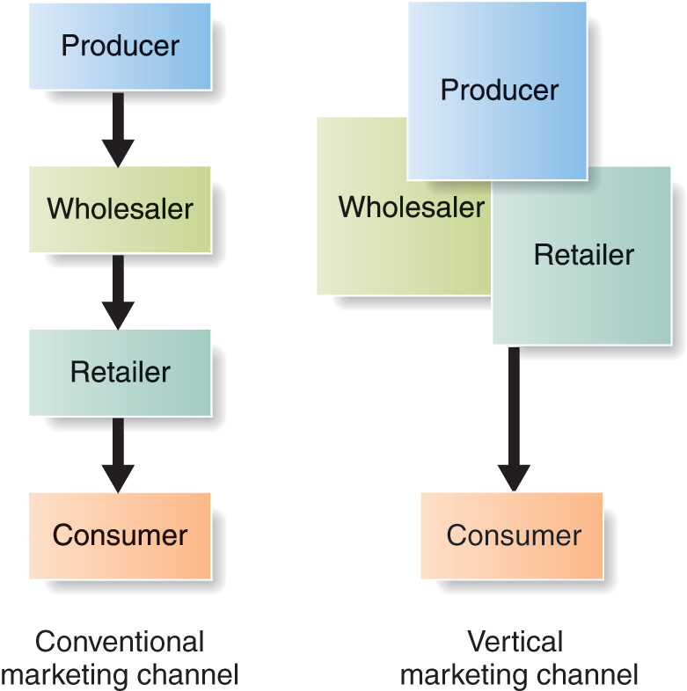
Conventional vs. Vertical Marketing Channel

Slide 26
Channel Behaviour and Organization
Vertical Market System (VMS)
Corporate VMS
Contractual VMS
Administered VMS
Integrates successive stages of production and distribution under single ownership – channel ownership is established through common ownership
Coordination and conflict through regular organizational channels

Slide 27
Channel Behaviour and Organization
Vertical Market System (VMS)
Corporate VMS
Contractual VMS
Administered VMS
Individual firms who join through contracts
Franchise organizations 特许经营机构
Manufacturer-sponsored retailer franchise system
Manufacturer-sponsored wholesaler franchise system
Service-firm-sponsored retailer franchise system

Slide 28
Channel Behaviour and Organization
Vertical Market System (VMS)
Corporate VMS
Contractual VMS
Administered VMS
Leadership through the size and power of dominant channel members
Leadership could be manufacturer or retailer

Slide 29
Channel Behaviour and Organization
Horizontal Marketing Systems
Companies at the same level work together with channel members
Multichannel Distribution Systems
Occurs when a firm uses two or more marketing channels
Changing Channel Organization
Disintermediation: occurs when product or service producers cut out marketing channel intermediaries or when radically new types of channel intermediaries displace traditional ones当产品或服务生产者削减营销渠道中介机构或当全新类型的渠道中介机构取代传统渠道中介机构时发生

Slide 30
Multichannel Distribution Systems
Advantages:
Expanding sales and market coverage
扩大销售和市场覆盖
Tailoring channels to satisfy specific needs of diverse consumer segments
定制渠道以满足不同消费群体的特定需求
Disadvantages:
Harder to control
Generating more conflict

Slide 31
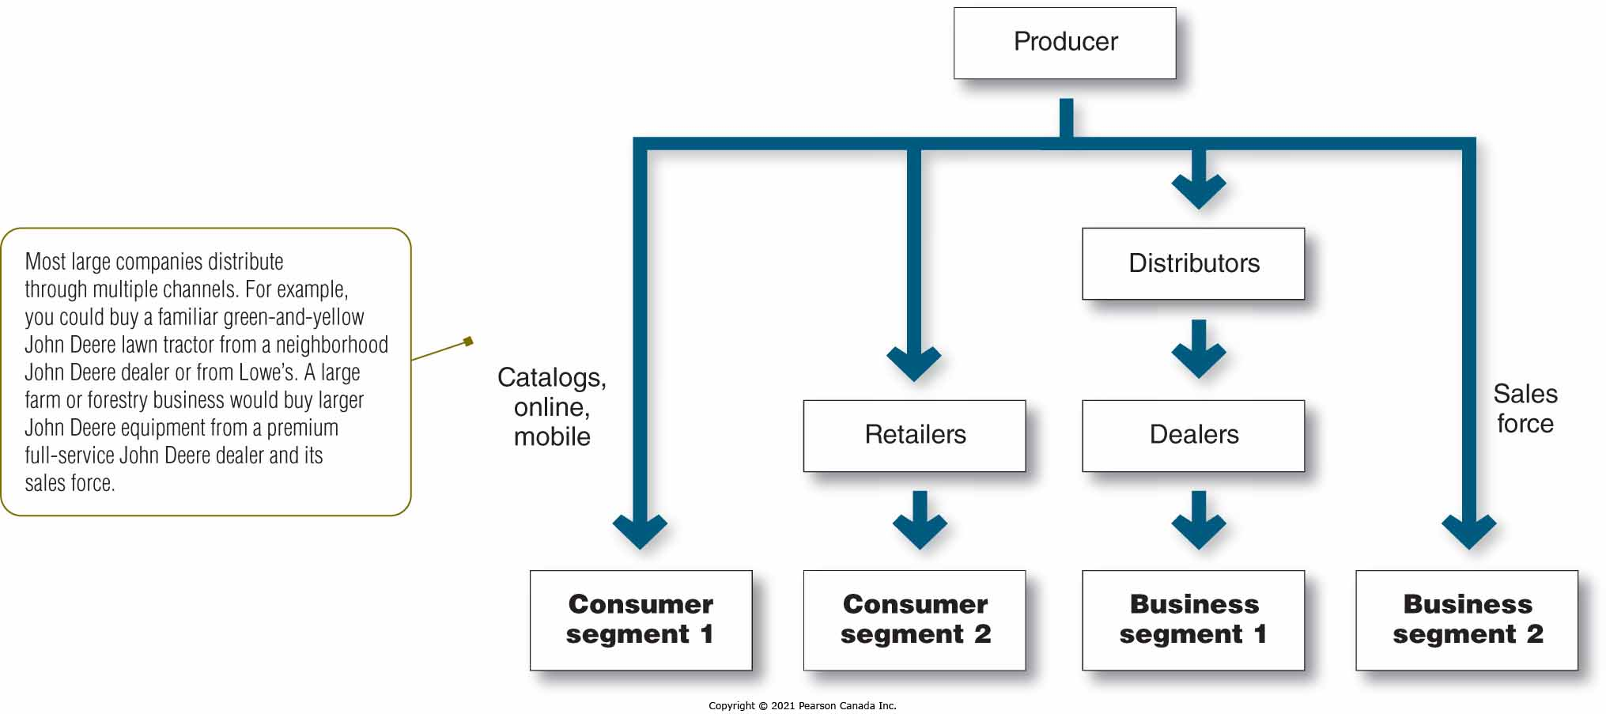
Multichannel Distribution System

Slide 32
Channel Design Decisions
Step 1: Analyzing Consumer Needs
Cost and feasibility of meeting needs must be considered
Step 2: Setting Channel Objectives
Set channel objectives in terms of targeted level of customer service
Many factors influence channel objectives
Nature of the company (size/financial position) and its products
Marketing intermediaries
Competition
Marketing environment

Slide 33
Channel Design Decisions
Step 3: Identifying Major Alternatives
Types of intermediaries refers to channel members available to carry out channel work.
Number of intermediaries to use
Intensive distribution
Exclusive distribution
Selective distribution
Responsibilities of each channel member

Slide 34
Identifying major alternatives
Number of Intermediaries
Also known as intensity of distribution
Intensity chosen should match with product types and how consumers buy the product
Strategy Description Example Purpose
Intensive
distribution
As many outlets
as possible
Convenience
goods
Maximize product exposure at the retail level
Selective
distribution
More than one, but
not all outlets
Shopping
goods
Enhance product image
Gain stronger support from the distributors.
Develop better relationships with distributor
Gain strongest support from the distributors.
Exclusive
distribution
One outlet per
market area
Specialty and
industrial
goods

Slide 35
Channel Design Decisions
Step 4: Evaluating Major Alternatives
Economic criteria
Control issues
Adaptive criteria

Slide 36
Designing International Channels
Channel strategies should be adapted to the existing structures within each country.
Distribution systems can have many layers and a large number of intermediaries.
Customs and government regulations can restrict distribution in global markets.

Slide 37
Channel Management Decisions
Selecting channel members
Managing and motivating channel members
Evaluating channel members

Slide 38
Public Policy and Distribution Decisions
Exclusive distribution
Exclusive dealing
When the seller requires that only certain dealers carry its products and also that these dealers not handle competitors' products,
Exclusive arrangements (Canadian Competition Act) are legal as long as the parties
Do not substantially lessen competition or tend to create a monopoly
Enter into the agreement voluntarily

Slide 39
Read Chapter 12

